Slide 1
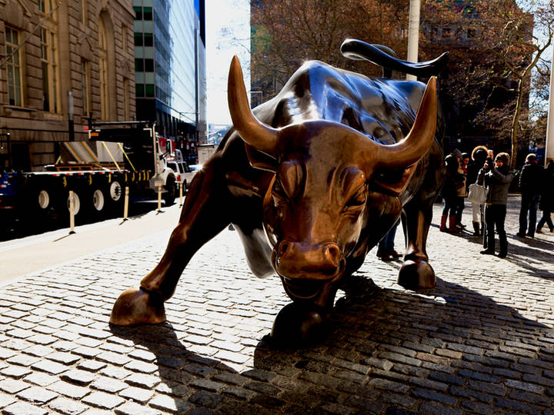
Stock Market Analysis using Clustering Techniques
By:
Deti Prudvi

Slide 2
Problem Statement
Nowadays most of the people have started investing the money in stocks and they look for stock market prediction is to determine the future value of a company stock on a financial exchange.
The clustering of a similar successful companies according to stock's future price will increase investor's profits.
Stock market trading results frequently change stock price which is risk for investors to invest or predict the behavior, and difficult for a company to know its financial status.
It helps people to analyse the similar good returning companies to invest their money with low volatility(risk factor).

Slide 3
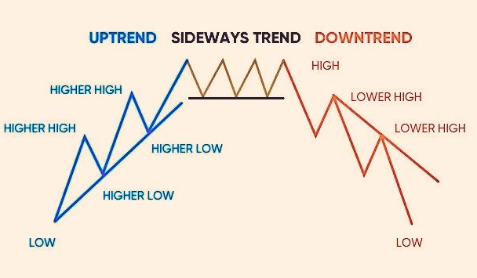
General terms related to the Stock Market
High : It is the highest price at which
the stock is traded during a period.
Low: It is the lowest price at which the
The stock is traded during a period.

Slide 4

General terms related to the Stock Market
3) Open Price: Open price is the price that the stock
Possessed when the starting bell rang
4) Closed Price: Closed price is the price value of the stock when
The stock exchange shop is closed .

Slide 5

General terms related to the Stock Market
5) Volume :
6) Adjusted Close Price:
Volume measures the number of shares traded in a stock or contracts traded in futures or options
The adjusted closing price amends a stock's closing price to reflect that stock's value after accounting for any corporate actions.

Slide 6
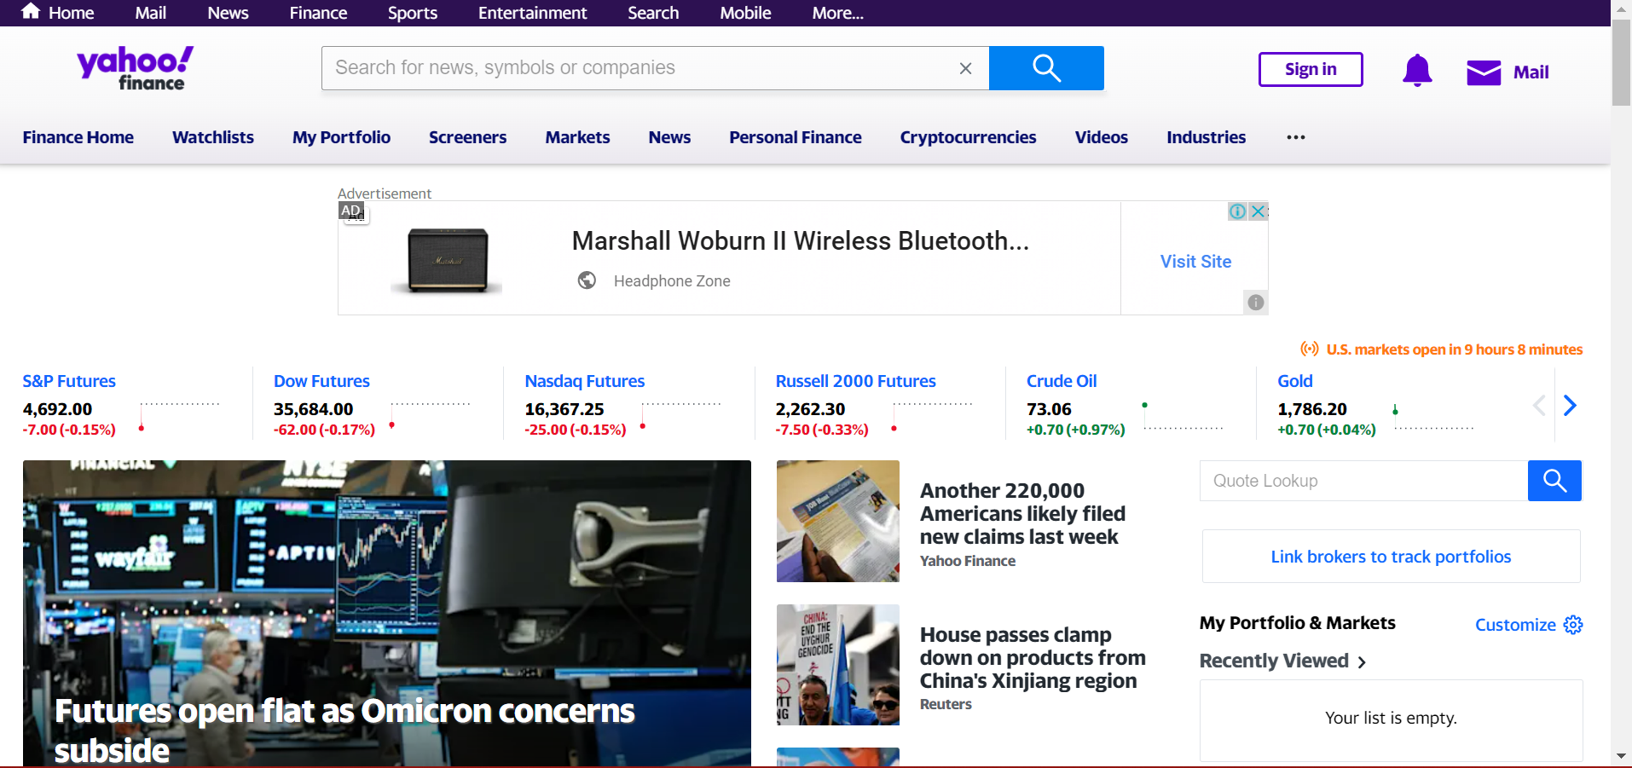
DataSet
We have taken Time Series Dataset from Yahoo finance.

Slide 7
Proposed Solution
The proposed method reports a case study in which the selected financial and stock time series data of over 24 stock indices are clustered into distinct group.
In this framework, we collect financial time series data from yahoo finance.
The dataset consists of 6 attributes (Adjusted close, close, low, open, high, volume).
We collect data for 24 companies in top 100 companies listed in NASDAQ.
Exploratory data analysis.
Pre process the data. (As dataset is of high dimension).

Slide 8
Proposed Solution cont.
Feature selection (Feature vector from the dataset for the clustering model).
Framework focuses on Adjusted close of the stock and open price as well as close price.
Closing and opening price merely refers to the cost of shares at the start and end of the day respectively.
The adjusted closing price analyzes the stock's dividends, stock splits and new stock offerings to determine an adjusted value.
The adjusted closing price reflects the change in stock value caused by new offerings from the corporation.
It can be called a more accurate measure of stocks' value.

Slide 9
Proposed Solution cont.
Movements is also one of the great to be considered, it is calculated with the opening and closing price.
Proposed method analyse how the features affect the clustering.
Best features selection and model selection using silhouette Coefficient or silhouette score.
Since stock market fluctuate every date, there is huge variations in the values.
Normalization and standard scalar methods are used to normalize the data.
Elbow method is used to find optimal number of cluster.

Slide 10
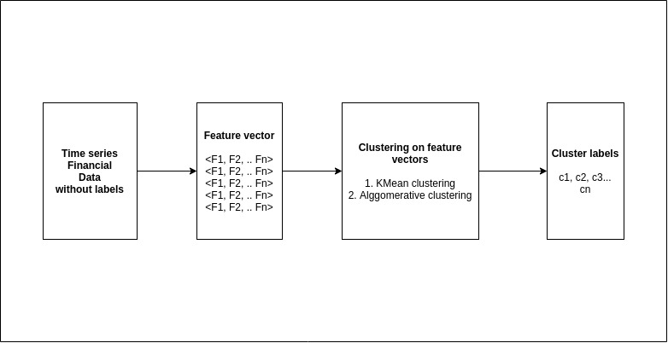
Architecture

Slide 11
Methodology
K Mean clustering and Agglomerative Clustering algorithms are used in this framework.
Silhouette score is used as benchmark for comparison between the algorithms for validation.
Run time comparison is done on both algorithms
Feature vector consists of:
Feature Vector
Returns
Volatility
Movements

Slide 12
Technology used
Language used : Python
Libraries : Numpy, pandas, pandas_datareader, sklearn, time, matplotlib and statistics.
Unsupervised Machine learning techniques.
Data collection is performed using python library on Yahoo finance website. (5 years)
Platform : Windows and Linux.

Slide 13
Results achieved
Case 1) Movement as feature vector (Opening and closing price).
Optimal number of clusters : 5
Silhouette score achieved : 0.11146220010327834
Disadvantage : As we know that it does not work well with higher dimension dataset.
Case 2) Dimension of movement vector is reduced by PCA
Optimal number of cluster : 5
Silhouette score achieved : 0.5654361468151378

Slide 14
Results Achieved
Case 3) Return and Volatility as a feature vector (K Means).
Optimal number of cluster : 6
Silhouette score achieved : 0.6945575771644393
Return and Volatility as feature vector (Agglomerative clustering )
Silhouette score achieved : 0.6692717218104942

Slide 15
Cluster analysis
Since the Silhouette score for the case 3 is high, we consider the same for analysis
Cluster 0: It describe that, investing in these stocks gives very low positive return with less volatility (risk factor).
Cluster 1: It describe that, investing in these stocks gives very Good positive return with moderate volatility (risk factor).
Cluster 2: It describe that, investing in these stocks gives negative return with high volatility (risk factor).

Slide 16
Cont.
Cluster 3: It describe that, investing in these stocks gives very good return with moderate volatility (risk factor).
Cluster 4: It describe that, investing in these stocks gives average return with moderate volatility (risk factor).
Cluster 5: It describe that, investing in these stocks gives average return with very less volatility (risk factor).

Slide 17
Conclusion
The KMeans with adjusted close value gave better results.
We performed analysis on case 3.
We can apply KMeans directly on raw time series dataset, mainly due to the course of dimensionality and cost of computation required for clustering.

Slide 18
THANK YOU

